Slide 1

Digital Solver
IMED 498
10/24/2023

Slide 2
Digital Solver: Intro
I had chosen this specific project since I had quite a passion for designing games and wanted to give a specific purpose when creating mine.

Slide 3

Digital Solver: Learning Outcomes
The purpose of this project is to help with the idea of using video games to teach and influence the minds of the ones who play.
I am hoping that with this project will give the idea that even the most interactives forms of entertainment can teach good lessons within them.

Slide 4
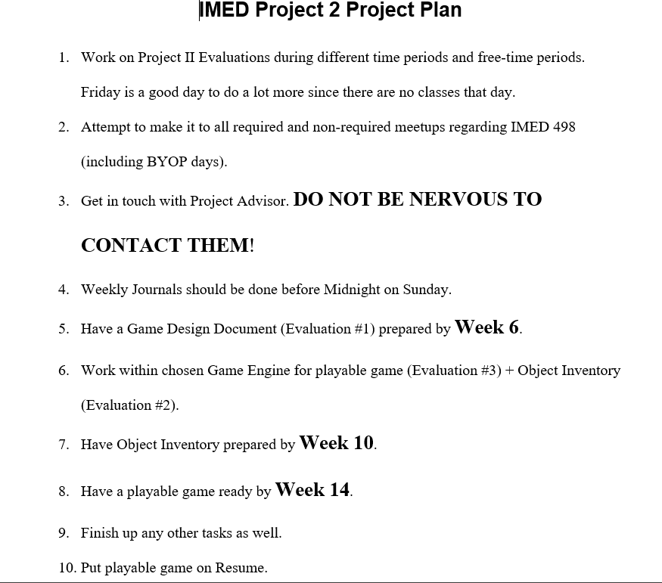

Digital Solver: Process
In terms of my project development, I am working quite hard on it, and I have gotten most of the listed tasks done.
I do have a bit of trouble at times meeting some of the given deadlines due to other necessities and some things not be able to be done before the other.

Slide 5

Digital Solver: Outcomes
Right now, I have the selected game engine that I plan to use for my project, and I am using other games as well to not only keep in my mind but also learn from them and how they can be ultimately helpful.
What’s left is to set up more of my object inventory content and working within the game engine itself to make this game possible.

Slide 6

Digital Solver: Challenges
I do have a bit of trouble at times meeting some of the given deadlines due to other necessities and assignments.
I may have to finish some other tasks before or after other ones due to some difficulties.
Undiagnosed ADHD, reaching out (still), game engine limits

Slide 7

References / Websites
https://gdevelop.io/academy
https://www.youtube.com/watch?v=4LTtr45y7P0
Brandse, M., Tomimatsu, K. (2013) Empirical Review of Challenge Design in Video Game Design. 398-406.

